Slide 1
Introduction to Conditional Random Fields
Speaker: Kangqi Luo
Apr. 26th, 2017

Slide 2
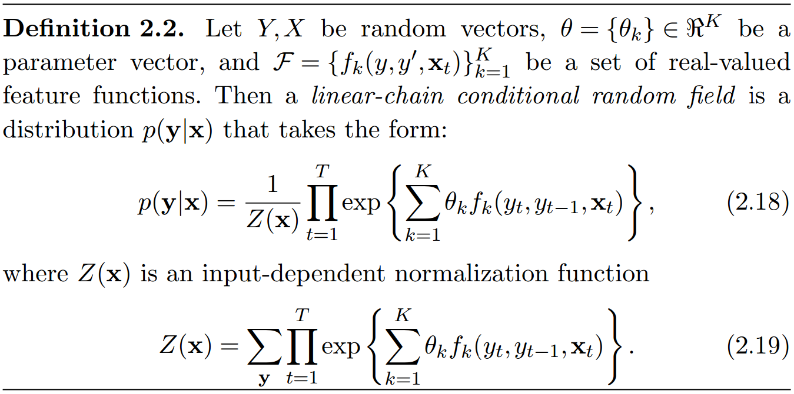
What the f*** is that ????

Slide 3
Content
Undirected Model & Factor Graph
Sequential Labeling as Running Example
Generative: Naive Bayesian, Hidden Markov Model
Discriminative: Logistic Regression, Conditional Random Field
Linear-Chain CRF
View of Factor Graph
View of Logistic Regression
View of Hidden Markov Model
Training & Inference
Conclusion

Slide 4
Undirected model & factor graph
A
D
B
C

Slide 5
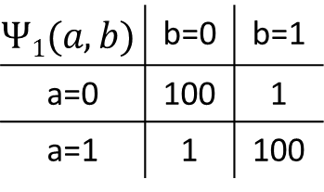
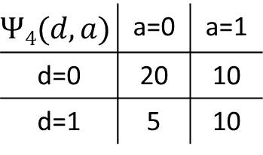
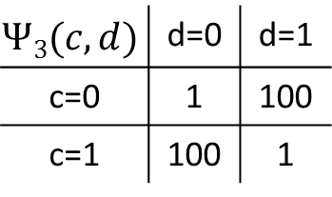
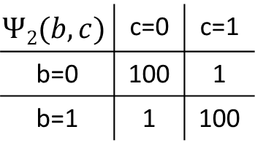
Undirected Graphical Model: Toy Example
$$Ψ4(d, a)$$ | a=0 | a=1
d=0 | 20 | 10
d=1 | 5 | 10
$$Ψ1(a, b)$$ | b=0 | b=1
a=0 | 100 | 1
a=1 | 1 | 100
Scenario: Discussing
Pro (0) & Con (1)
Opinions interactive between each other
Undirected Edge
Factor Graph
A
D
B
$$Ψ3(c, d)$$ | d=0 | d=1
c=0 | 1 | 100
c=1 | 100 | 1
$$Ψ2(b, c)$$ | c=0 | c=1
b=0 | 100 | 1
b=1 | 1 | 100
C
Notes:
Scenario: ABCD are sitting around a table, discussing a controversial topic (for example, whether Trump should but the wall at the border of mexico)
They discuss and influence opinions with each other.
After discussing, each person holds their final opinion (pro or con), we use random variable a,b,c,d.
We use the function to represent whether two people tend to agree or disagree with each other.
AB, BC: good friends
CD: conlict
Influences with each other, can’t draw a Bayesian Network, that is, there’s no directed edges between RV.
But we use undirected as instead.
Factor graph: psai: factors
========
Factor graph: modeling joint / conditional probability (compared with Bayesian Network)
Introducing an example for undirected models
And I’ll show u how to use the factor graph.
ABCD are discussing a controversial topic
We try to model their joint probability p(a,b,c,d)
Interactive between each other (without a directed edge)
So we can’t use p(d|c) but rather using $Ψ3(c, d)$ as a factor function.
类比directed graph
Why use graphical model? Easy to describe dependencies
Goal: Infer the opinion of each person
joint prob: max P(a,b,c,d)
cond. prob: max P(a,b,c|d)
不直观
We will use the term random field to refer to a particular distribution among those defined by an undirected model

Slide 6
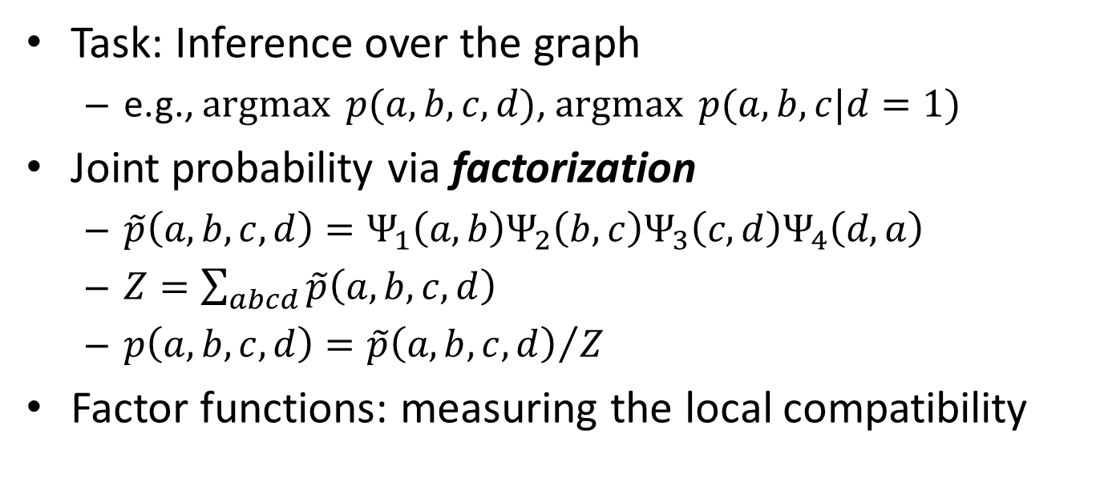
Undirected Graphical Model: Toy Example
Task: Inference over the graph
e.g., $\operatorname{argmax}{p(a, b, c, d)}$, $\operatorname{argmax}{p(a,b,c|d=1)}$
Joint probability via factorization
$\tilde{p}\left(a,b,c,d\right)=Ψ_{1}\left(a,b\right)Ψ_{2}\left(b,c\right)Ψ_{3}\left(c,d\right)Ψ_{4}\left(d,a\right)$
$Z=\sum_{abcd}{\tilde{p}\left(a,b,c,d\right)}$
$p\left(a,b,c,d\right)={\tilde{p}\left(a,b,c,d\right)}/Z$
Factor functions: measuring the local compatibility
Notes:
Goal: given all the factor functions, predict the opinion of each person when the discussion is over.
That is, we do the inference on this factor graph.
Model the prob distribution by a factorization according to given factors
Factor function: measuring the local compatibility between random variables.
must be larger than 0
Later I’ll show you that the factor function is just another representation of feature functions that we used in many classification tasks.
========
Inference: factors are known
first one: joint, second one: conditional
Factor function: measuring the compatibility (coherence) >= 0
Energy: 可正可负 (or say scoring function)

Slide 7

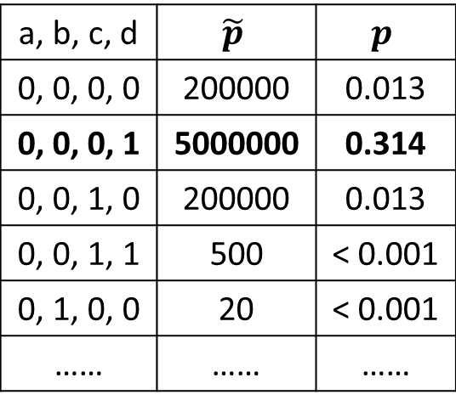
Joint Inference on Undirected Graph
a, b, c, d | $$\tilde{p}$$ | $$p$$
0, 0, 0, 0 | 200000 | 0.013
0, 0, 0, 1 | 5000000 | 0.314
0, 0, 1, 0 | 200000 | 0.013
0, 0, 1, 1 | 500 | < 0.001
0, 1, 0, 0 | 20 | < 0.001
…… | …… | ……
20 | 10
5 | 10
A
100 | 1
1 | 100
D
B
1 | 100
100 | 1
100 | 1
1 | 100
C
$$\operatorname{argmax}{p\left(a, b, c, d\right)=\{0, 0, 0, 1\}}$$

Slide 8
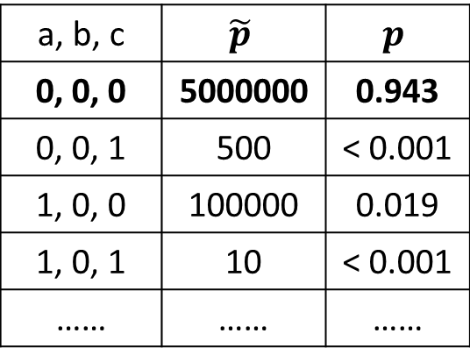

Conditional Inference
a, b, c | $$\tilde{p}$$ | $$p$$
0, 0, 0 | 5000000 | 0.943
0, 0, 1 | 500 | < 0.001
1, 0, 0 | 100000 | 0.019
1, 0, 1 | 10 | < 0.001
…… | …… | ……
20 | 10
5 | 10
A
100 | 1
1 | 100
A
D=1
B
D
B
1 | 100
100 | 1
100 | 1
1 | 100
C
C
$$\operatorname{argmax}{p\left(a, b, c, d=1\right)=\{0, 0, 0\}}$$
Notes:
D: Observed variable
We convert this graph with tabular scores into a tight version
Gray: observed
White: variables to be predicted
square: factor function between those variables it connected.

Slide 9
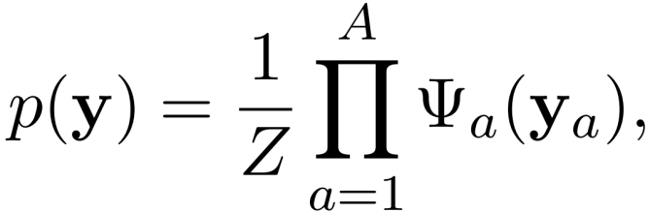
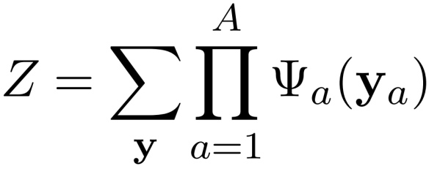

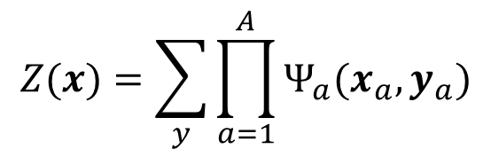
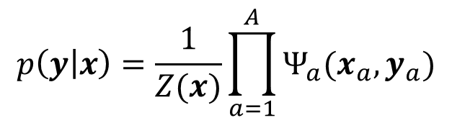
Probability Distribution on Factor Graph
$y_{a}$: Variables used in the $a$-th factor function
$x$: Observed variables
Random Field
$$p\left(y | x\right)=\frac{1}{Z(x)}\prod_{a=1}^{A}{Ψ_{a}(x_{a},y_{a})}$$
$$Z(x)=\sum_{y}{\prod_{a=1}^{A}{Ψ_{a}(x_{a},y_{a})}}$$
Conditional Random Field
Notes:
Write on board: RF and CRF
The general form of how the prob. factorizes according to an undirected model
The prob is proportional to the multiplication of all factor functions, normalized by Z.
We will use the term random field to refer to a particular distribution among those variables defined by an undirected model
========
Factor functions
That is CRF!
Definition 2.3. Let G be a factor graph over X and Y . Then (X,Y ) is a conditional random field if for any value x of X, the distribution p(y|x) factorizes according to G.
Z(x): normalization constant over the given observed data x
Here x can be word, y can be POS-tag
Also x can be pixels, y can be object classes
When applying the model, we train the factor function given the training data, and then do inference tasks.
Goal: inference & learning
Found interesting connections from generative and discriminative model
Under specified features and weights, the disc. model could reach the same probability distribution as the gen. model.

Slide 10
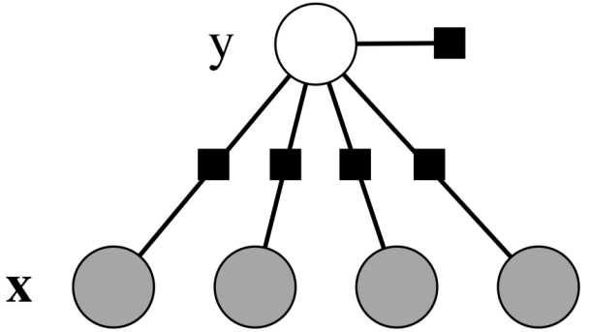










Running example: sequential tagging
$$y$$
$$y1$$
$$y2$$
$$y3$$
$$w1$$
$$w2$$
$$w3$$
$x$₁
$x$₂
$x$_{K}
Notes:
Models
Generative: Naive Bayesian, HMM
Discriminative: LR, MEMM, CRF

Slide 11
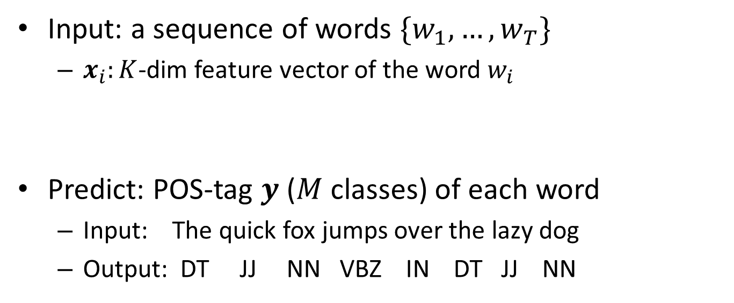
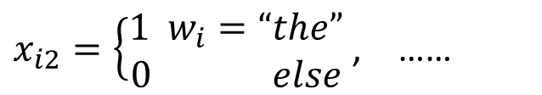
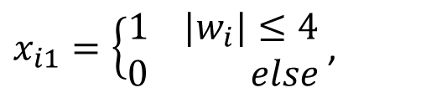
Sequential Tagging Problem
Input: a sequence of words $\{w_{1}, …, w_{T}\}$
$x_{i}:K$-dim feature vector of the word $w_{i}$
Predict: POS-tag $y$ ($M$ classes) of each word
Input: The quick fox jumps over the lazy dog
Output: DT JJ NN VBZ IN DT JJ NN
$x_{i1}=\left\{\begin{aligned}1 |w_{i}|≤4 \\ 0 else\end{aligned}\right.$ ,
$x_{i2}=\left\{\begin{aligned}1 w_{i}=“the” \\ 0 else\end{aligned}\right.$ , ……
Notes:
input: sentence (T words)
each word: K-dim
output: M different pos tags
vector: fingerprints of the word
feature engineering, or through NN
========

Slide 12
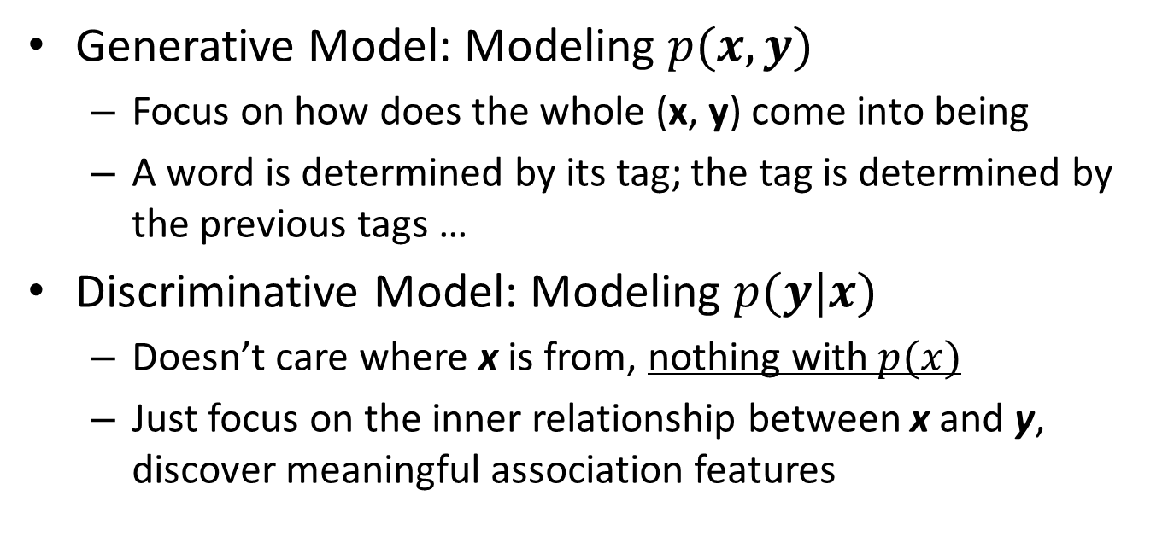
Generative v.s. Discriminative
Generative Model: Modeling $p(x, y)$
Focus on how does the whole (x, y) come into being
A word is determined by its tag; the tag is determined by the previous tags …
Discriminative Model: Modeling $p(y|x)$
Doesn’t care where x is from, nothing with $p(x)$
Just focus on the inner relationship between x and y, discover meaningful association features
Notes:
In the following slides, I will talk about several models,
focus on how the model is learnt and how to do inference on the new sentences.
========

Slide 13
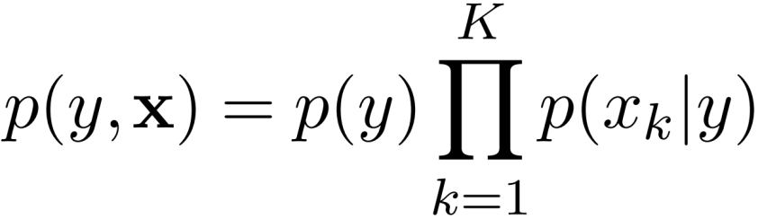

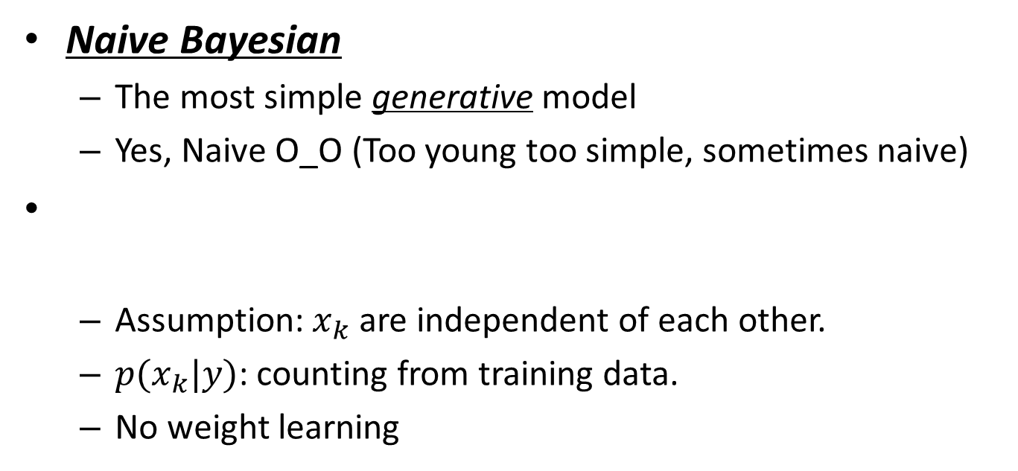



Tagging Problem: Single Word Only
Naive Bayesian
The most simple generative model
Yes, Naive O_O (Too young too simple, sometimes naive)
Assumption: $x_{k}$ are independent of each other.
$p(x_{k}|y)$: counting from training data.
No weight learning
$$y$$
$x$₁
$x$₂
$x$_{K}
Notes:
First: just focus on one word
predict its tag given the current word
Directed model (bayesian network, rather than a factor graph)
strong assumption: independent of each other
As u can see, p(x_k|y) is equally treated without any weights indicating which features are more reliable.
The learning step is simple: we just need to estimate p(y) and p(xk|y) based on the training data.
So just give me some training data, and I could build the model and predict the new sentences immediately, without iteratively training step.
========

Slide 14

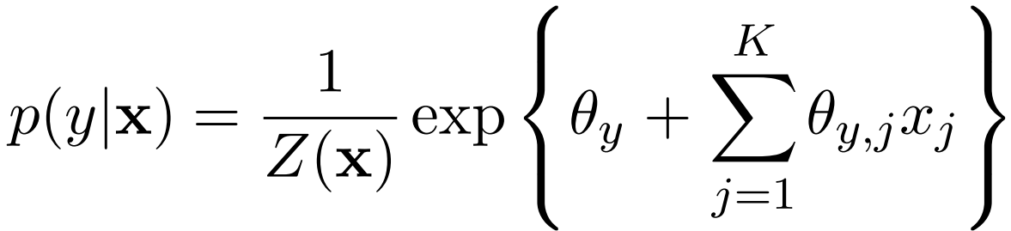

Tagging Problem: Single Word Only
Logistic Regression
The most simple discriminative model
$θ$: Weights of each feature
Learnt via Gradient Descent
Notes:
Write loss on the whiteboard
LR = Max Entropy Classifier
in this formula, we care about neither p(x), or the likelihood p(x|y), but just use parameter theta to fit the posterior probability p(y|x).
theta stands for weights for each feature.
theta yj: association feature between x_j and y
theta y: prior feature
========
log-linear: has weight to control the contribution of each feature
so can handle the case if feature has strong co-relation (for example, two features are exactly the same)
but what if in generative model: p(y|x) → p(y) \mul_i p(x_i|y)
if two features are strongly correlated, the p(x_i|y) is used twice without any other restriction, which actually changes the distribution.
========
M+KM parameters
K→M*K feature functions
exp{w*f}: Factor
Energy function is what we want to learn.
Weight * Feature function
discriminative: deal with unseen word
what if we deal it the same, but using generative model?

Slide 15

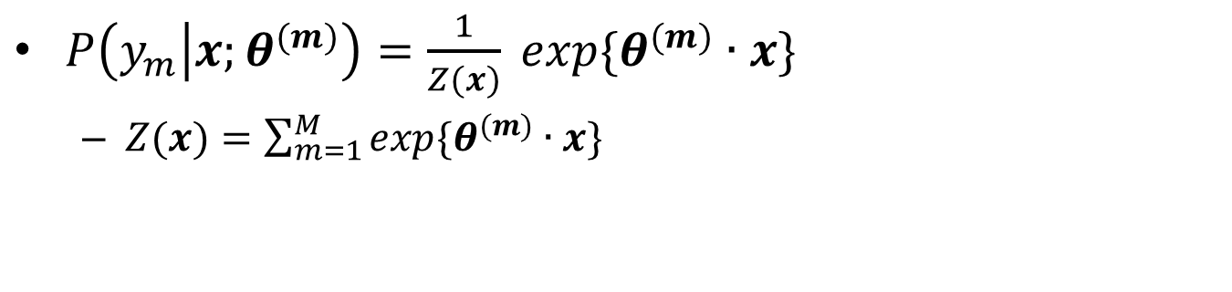


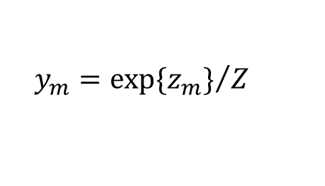



Softmax Regression
$P\left(y_{m} | x;θ^{(m)}\right)=\frac{1}{Z(x)} exp\{θ^{(m)}∙x\}$
$Z(x)=\sum_{m=1}^{M}{exp⁡\{θ^{(m)}∙x\}}$
x₁
3.2
$$θ^{\left(1\right)}$$
z₁
y₁
IN
$$y_{i−1}=VBZ$$
1
probability
of tags
features
-0.8
1
x₂
$$|w_{i}|≤4$$
$$θ^{\left(m\right)}$$
z_{K}
y_{K}
JJ
-5.2
x_{K}
$$z_{m}=θ^{\left(m\right)}∙x$$
$$y_{m}={exp⁡\{z_{m}\}}/Z$$
$$w_{i}="the"$$
0
| Linear | normalization |
Notes:
then the we measure the cond. prob. of y_k based on feature vectors and the corresponding parameter theta_k
don’t worry about the formula, the following figure shows how it works.
input fv: feature vectors of some case, output y: cond. prob. for each class
recap the previous example and feature functions, obviously we have fv1 = 1, ……
z_k represents the confidence score of assigning the k-th POS tag for this case, which is a linear comb. between fv and theta.
the step from z to y is just a normalization, turning confidence scores into probs.
In terms of training, we generate a loss function based on conditional probability for each training data, and adjust weight theta by minimizing the loss functions
the final weight shows the association between a semantic clue and a canidate POS tag.

Slide 16
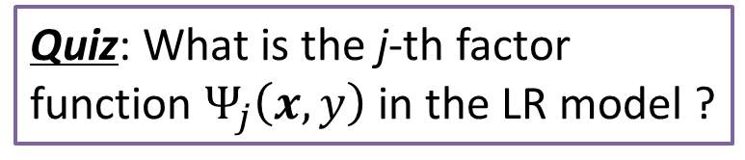
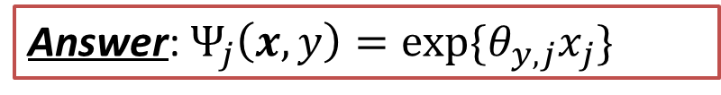
Logistic Regression as Undirected Model
Quiz: What is the j-th factor function $Ψ_{j}\left(x,y\right)$ in the LR model ?
Factor graph of logistic regression
Answer: $Ψ_{j}\left(x,y\right)=exp⁡\{θ_{y,j}x_{j}\}$
Notes:
Compare with the general formula of conditional prob on the undirected graph, we could find that: this exp_add part is the multiplication of many factor functions.
Quiz & Answer
========
Explain the factor graph:
Unlike directed model, where x is conditioned on y (represented by conditional prob)
Here we define factor function between y and each feature of x.
The exp{} ensure that the factor is always >= 0, and the inner part \theta * x is called energy function, or sometimes I call it scoring function

Slide 17
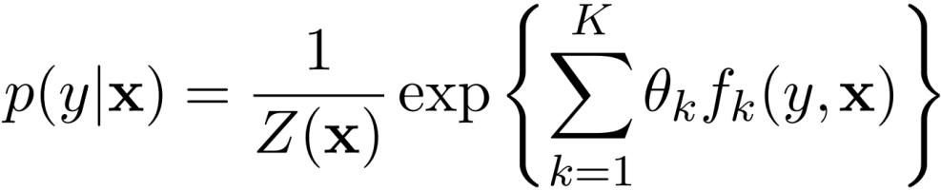

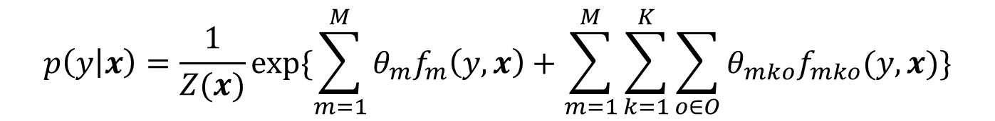


Notation Tricks in Logistic Regression
$$p\left(y | x\right)=\frac{1}{Z(x)}exp⁡\{\sum_{m=1}^{M}{θ_{m}f_{m}\left(y,x\right)}+\sum_{m=1}^{M}{\sum_{k=1}^{K}{\sum_{o∈O}{θ_{mko}f_{mko}(y, x)}}}\}$$
$f_{∗}\left(y,x\right)$: the feature function of the $\left(x,y\right)$ pair.
$f_{mko}\left(y, x\right)=1_{\{y=m\}}1_{\{x_{k}=o\}}$
$f_{m}\left(y,x\right)=1_{\{y=m\}}$
$$y$$
$$x$$
Notes:
Write feature functions on board
explain the formula in more detail
x_k: discrete value in O (0 or 1)
expand the formula and introduce the notation of feature functions
1: indicator function
Params: M + KMO features
Each factor function: exp{feature_function} K=M+KMO
========
Another formula: easier for understanding: K different feature functions (considering y)
离散化！！！
Turning k-dim feature vector into K+KM feature functions
Taking (x, y) as the input, true / false as the output
This one: easy to understand,
former one: easy to draw a more clear factor graph.

Slide 18
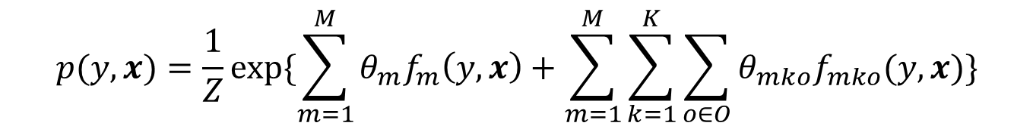



Naive Bayesian v.s. Logistic Regression
$$Z≡1$$
set $θ_{m}=\log{p(y=m)}$
Generative-Discriminative Pair
set $θ_{mko}=\log{p\left(x_{k}=o\right|y=m)}$
$$p(y, x)=\frac{1}{Z}exp⁡\{\sum_{m=1}^{M}{θ_{m}f_{m}\left(y,x\right)}+\sum_{m=1}^{M}{\sum_{k=1}^{K}{\sum_{o∈O}{θ_{mko}f_{mko}(y, x)}}}\}$$
Notes:
Found interesting connections from generative and discriminative model
Since \theta is a parameter, weight could change,
Under specified features and weights, the disc. model could reach the same probability distribution as the gen. model.

Slide 19






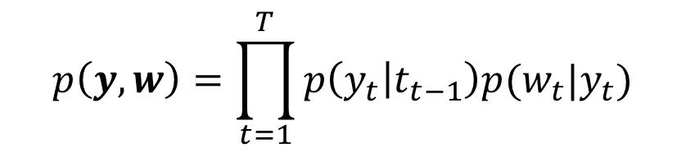
Hidden Markov Model
Now we take the correlation between words
Bigram HMM
Train: Counting from data
Inference: Veterbi Algorithm
$$y1$$
$$y2$$
$$y3$$
$$p\left(y,w\right)=\prod_{t=1}^{T}{p\left(y_{t} | t_{t−1}\right)p(w_{t}|y_{t})}$$
$$w1$$
$$w2$$
$$w3$$
Notes:
模型：找到x和y之间的关系，建立起一定的条件假设（谁和谁独立，谁和谁不独立）

Slide 20

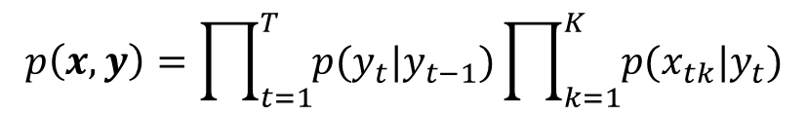





HMM + NB
Incorporating with features
Could be problematic because the independence assumptions can hurt performance.
$$y1$$
$$y2$$
$$y3$$
$$p\left(x,y\right)=\prod_{t=1}^{T}{p(y_{t}|y_{t−1})}\prod_{k=1}^{K}{p(x_{tk}|y_{t})}$$
$$x1$$
$$x2$$
$$x3$$
Notes:
信息都已经准备好了 就是如何使用进去
Most similar with CRF

Slide 21






Linear-chain CRF
$$y1$$
$$y2$$
$$y3$$
$$w1$$
$$w2$$
$$w3$$

Slide 22




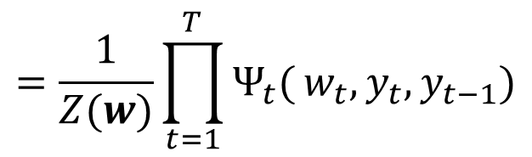


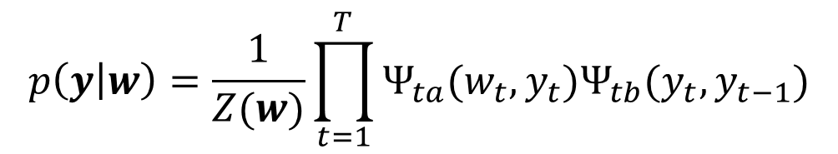

Linear-Chain CRF: View of Factor Graph
Turning directed model into undirected
adjacent tags influences with each other
Relax the assumption that $yi$ is determined by $y_{i−1}$ only
$$p\left(y | w\right)=\frac{1}{Z(w)}\prod_{t=1}^{T}{Ψ_{ta}(w_{t},y_{t})Ψ_{tb}(y_{t},y_{t−1})}$$
$$y1$$
$$y2$$
$$y3$$
$$=\frac{1}{Z(w)}\prod_{t=1}^{T}{Ψ_{t}(}w_{t},y_{t},y_{t−1})$$
$$w1$$
$$w2$$
$$w3$$
Notes:
Recap LR: define the factor function
从HMM出发，先通过gen-dis pair变成某种形式，再学着NB引入更多的feature
disc model → 配上特定的参数 → generative model （gen的好处：Z=1）
改形式
Joint model (can’t step by step)

Slide 23
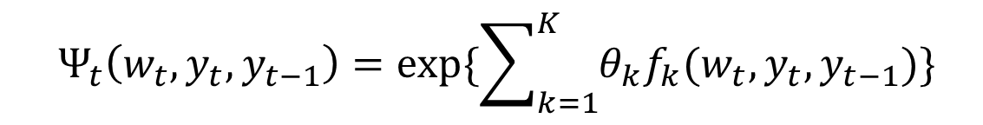


Linear-Chain CRF: View of Factor Graph
$$y$$
Recap Logistic Regression
Factor function in Linear-Chain CRF
How to define $f_{k}(w,y,y_{prev})$
How to do inference and learn the weights $θ$
$$Ψ(y,x)$$
$$Ψ_{t}\left(w_{t},y_{t},y_{t−1}\right)=exp⁡\{\sum_{k=1}^{K}{θ_{k}f_{k}(w_{t},y_{t},y_{t−1})}\}$$
$$x$$
Notes:
We got the structure, but need more detail
I will answer the question in the later slides

Slide 24
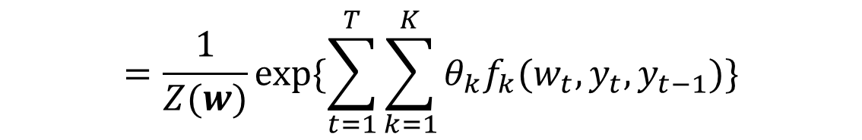
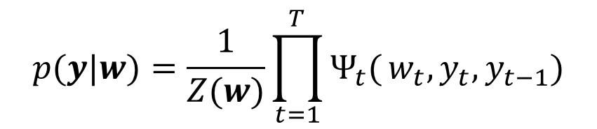
Linear-Chain CRF: View of Logistic Regression
$$p(y|w)=\frac{1}{Z(w)}\prod_{t=1}^{T}{Ψ_{t}(}w_{t},y_{t},y_{t−1})$$
$$=\frac{1}{Z(w)}exp⁡\{\sum_{t=1}^{T}{\sum_{k=1}^{K}{θ_{k}f_{k}(w_{t},y_{t},y_{t−1})}}\}$$
Extracting the overall features of the entire sequence
Sum feature values of each position together.
Sharing weights across different position of words.
Notes:
Entire sequence
Z(w) is hard to calculate

Slide 25

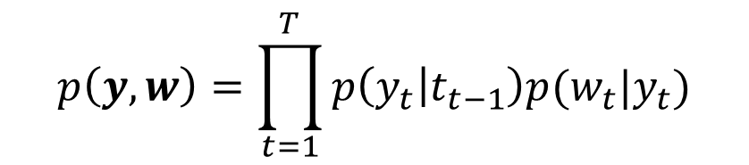
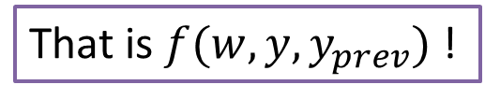


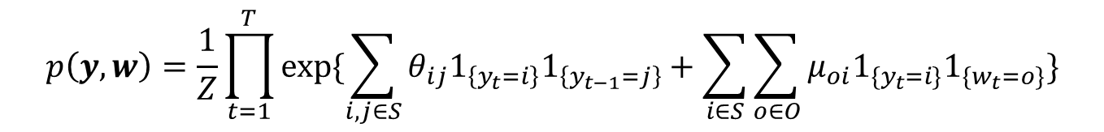

Linear-Chain CRF: View of HMM
Leverage generative-discriminative pair
$$p\left(y,w\right)=\prod_{t=1}^{T}{p\left(y_{t} | t_{t−1}\right)p(w_{t}|y_{t})}$$
That is $f(w, y,y_{prev})$ !
set $θ_{ij}=\log{p\left(y=i \right|y_{prev}=j)}$
$$S∗S$$
$$S∗O$$
set $μ_{oi}=\log{p\left(w=o\right|y=i)}$
$$p\left(y,w\right)=\frac{1}{Z}\prod_{t=1}^{T}{exp⁡\{\sum_{i,j∈S}{θ_{ij}1_{\left\{y_{t}=i\right\}}1_{\left\{y_{t−1}=j\right\}}}+\sum_{i∈S}{\sum_{o∈O}{μ_{oi}1_{\{y_{t}=i\}}1_{\{w_{t}=o\}}}}\}}$$
Notes:
We can directly convert HMM into LC-CRF so that you can have a clear understanding what is the feature function
S: all POS tags
O: all candidate words
S*S + S*O feature functions

Slide 26
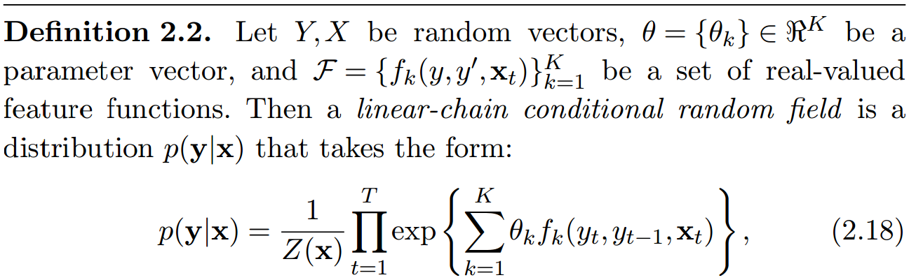
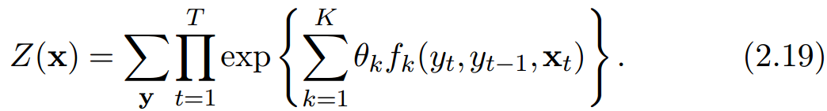
Final: Definition of Linear-Chain CRF

Slide 27
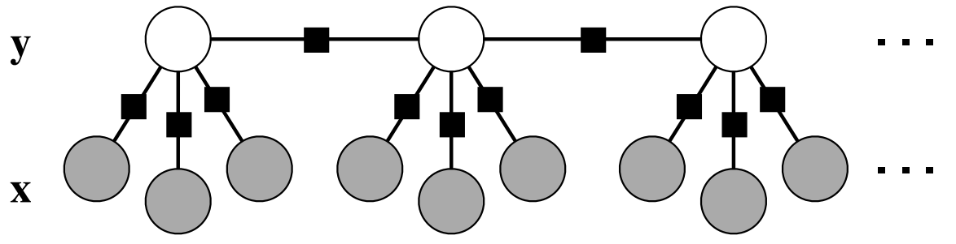

Linear-Chain CRF: Diff. Feature Functions
$f_{ij}\left(y,y_{prev}\right)=1_{\left\{y=i\right\}}1_{\left\{y_{prev}=j\right\}}$
$g_{iko}\left(y,x\right)=1_{\left\{y=i\right\}}1_{\left\{x_{k}=o\right\}}$

Slide 28
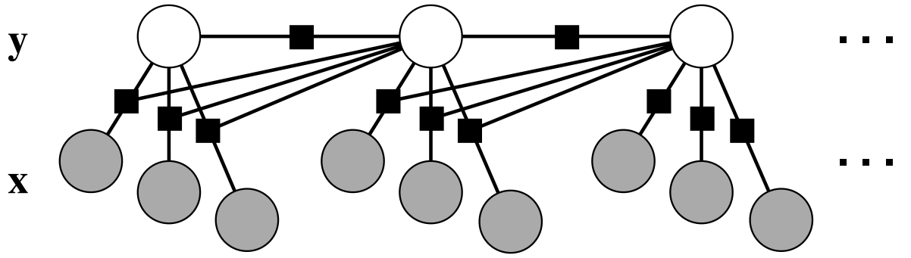
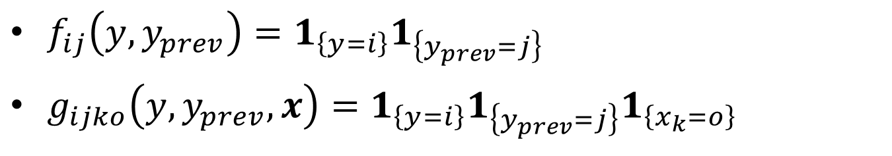
Linear-Chain CRF: Diff. Feature Functions
$f_{ij}\left(y,y_{prev}\right)=1_{\left\{y=i\right\}}1_{\left\{y_{prev}=j\right\}}$
$g_{ijko}\left(y,y_{prev},x\right)=1_{\left\{y=i\right\}}{1_{\left\{y_{prev}=j\right\}}1}_{\left\{x_{k}=o\right\}}$
Notes:
I just give u two example, which is straightforward.
But since the feature function f() could be anything.

Slide 29
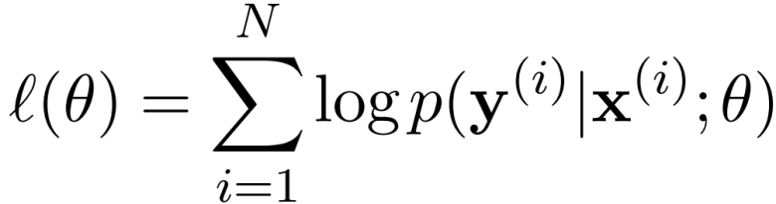
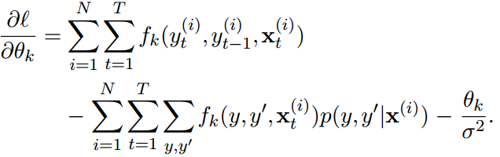
Linear-Chain CRF: Inference & Learning
Learning: Gradient Descent based on MLE
Inference: Variant of Viterbi Algorithm
Similar with Inference in HMM
Dynamic Programming

Slide 30
Conclusion
CRF is an undirected & discriminative model
p(y|x) factorizes according the factor graph
Compared with Logistic Regression:
Extract features for the whole sequential input
Sum feature values together, and share weights
Compared with HMM:
LC-CRF relaxed the directed dependency between variables
Incorporating word features, avoid the independence assumption (introducing feature weights)
Notes:
然后linear chain CRF和HMM的区别：是判别式模型和生成模型的区别，是函数拟合和概率模型的区别。

Slide 31
More General CRF ……
Fully connected CRF
Image object classification
Entity linking in web table
Learning and inference becomes much complicated
Approximate inference

Slide 32
Move to Real Example: Sequence Labeling
More complex dependencies
How does the name CRF come from?

Slide 33
What is Structured Prediction
Examples
POS-Tagging
Wikification (Check Wikifier Paper)
Entity Linking in Tables
Image Object Classification
Predicting Structured Objects, rather than simple values (discrete or continuous)

Slide 34
Structured Prediction: A Joint View
Capturing Conditional Dependence
Coherence
Style: P(Y|X)

Slide 35
HMM, MEMM
Simplified the problem: P(y_i | y_i-1, X)
Markov Property
What would happen if the dependence goes more general?
What if there doesn’t contain a explicit sequence?
Table Linking, Image Object Classification

Slide 36
Graph Between HMM, Log-Linear and MEMM
Basian → Log-linear (factorize)
Factorized → CRF
Thinking a little bit …
Notes:
Graph model overview (why we use this model, for inference, and for representing the connection between variables)
There are simple graph models (single-item prediction, or sequential tagging, or more complex)
Spam detection (generative vs discriminative)
generative: generate detail things, rather than fingerprints.
Quiz: Which adv for generative model?
Undirected graph, introducing factor, factorization
Energy, potential (structure like a big Logistic Regression)
Why we need undirected graph: adv and disadv
relaxed dependency
But need normalization (directed graph is special: no need to normalize)
The most simple undirected graph
From Naive Bayes to simple logistic regression ??
At least the figure shows us so.
HMM, MEMM (directed discriminative), Linear-Chain CRF
Several structures (from 2011 paper)
Inference and Learning
fff
fff

Slide 37
Graph Model (MRF, CRF)
We should talk about how does the formula come from.
First: MRF explanation
Second: MRF formula
Energy v.s. Potential (Compare with Log-Linear function)
Larger entity → lower probability to occur in the real world.

Slide 38
CRF Explanation – Undirected Graph
Undirected Graph
What is Factor
Factor graph: distribution by multiplication
Adv and Disadv
no edge dependency
normalization is huge 不直观
Factors are unknown right now.
Notes:
factor graph, factorization, energy & potential
Put the figure here?
“coherence”

Slide 39
Dense CRF
Fully Connected (Just one Clique???)

Slide 40
THANKS FOR listening!
Question & Answers

